Slide 1
CLIMATE NEUTRAL FOOD AND WOOD:
Showcasing best climate practices in agriculture, forestry, food systems and the bioeconomy
Climate credits
a new tool to enhance forests’contribution
to EU mitigation goals
through multifunctional forest management
Project Session Forestry mitigation
Oct 8th, 2020
LIFE CLIMARK (LIFE16 CCM/ES/000065) has been funded by the Climate mitigation Action of the EU LIFE Program

Slide 2
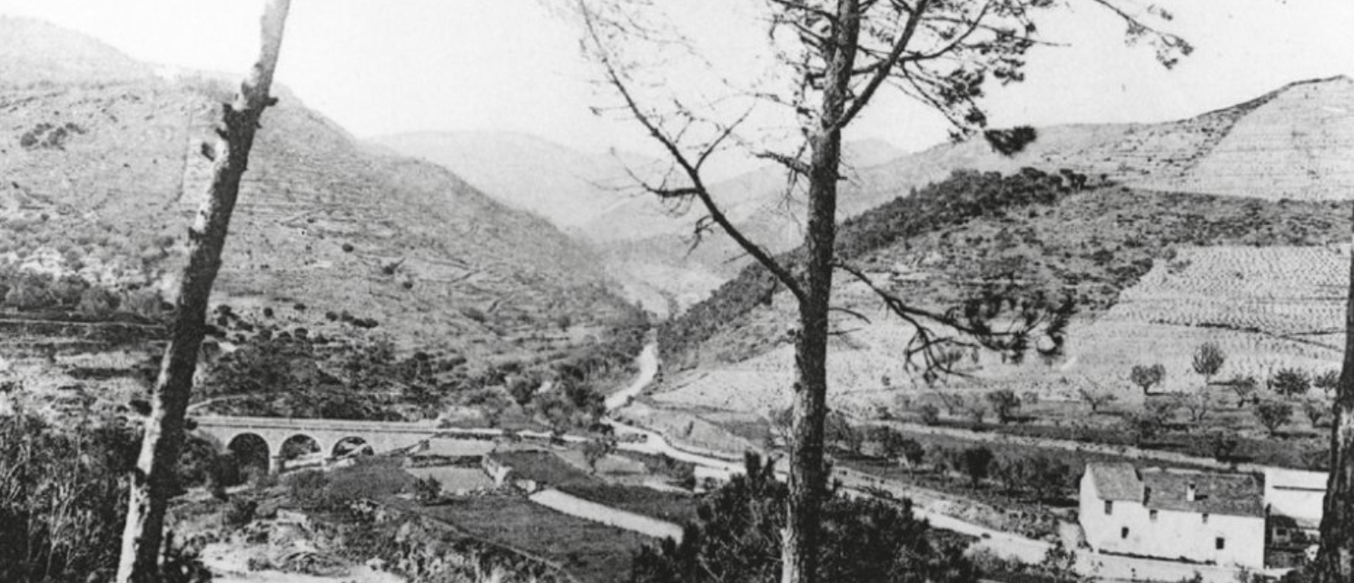
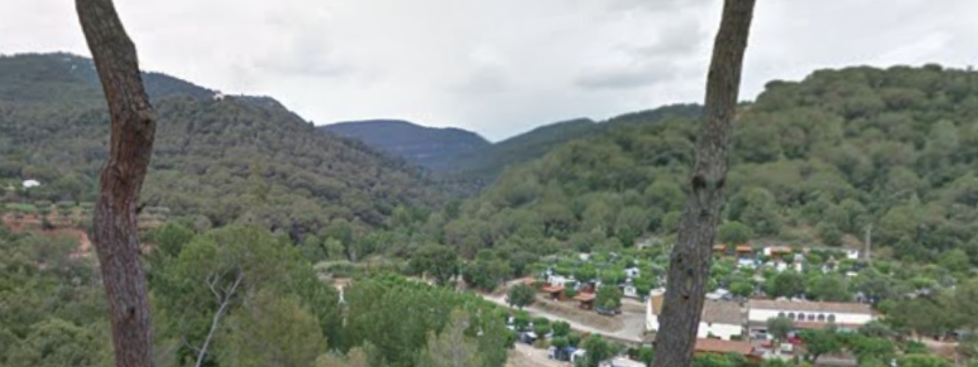
Just planting trees doesn't solve our climate problem
In fact, too many trees can make it worse:
The great expansion and densification of our Mediterranean forests has reduced CO2 sink capacity & increased fire risk, and has reduced water availability
Our Mediterranean forests need to be managed… again !
European forests absorb 13% of total EU emissions, but we are observing the first symptoms of saturation in the carbon sink capacity of European forests, which will go worst.
In Catalonia, the rate of C0₂ sequestration has dropped in forests by 17% in the last 25 years, and fire and other natural disturbances are threatening the carbon stocks accumulated in the last 50 years. Water flow in rivers has been reduced by 30%.
1950
2020

Slide 3
MITIGATION is a necessary goal ……..
… but not sufficient: we need ADAPATION & (inclusive) BIOECONOMY
Multifunctional forest management
+ carbon sequestration
+ water provision
+ biodiversity conservation
+ renewable raw material &energy+ local development
Sustainable forest management could increase forests sink capacity by up to 20% (Nabuurs et al, 2017)
Protecting carbon stocks
Substitution effect
ADAPTATION
BIOECONOMY
Increasing C sink capacity capacity
Climate-smart forestry
MITIGATION
Landscape restoration

Slide 4
How can we make multifunctional forest management occur?
Finding new financing ways for forestry
A paradigm shift:
from selling only forest products to selling a bundle of ecosystem services
In Mediterranean countries, the lack of forest management due to low profitability, is threatening the provision of Forest Ecosystem Services (FES), but……
….private forests owners (78% in Catalonia) have no incentives to manage their forests for FES conservation
$$+$$
Climate regulation
Biodiversity
Water regulation

Slide 5
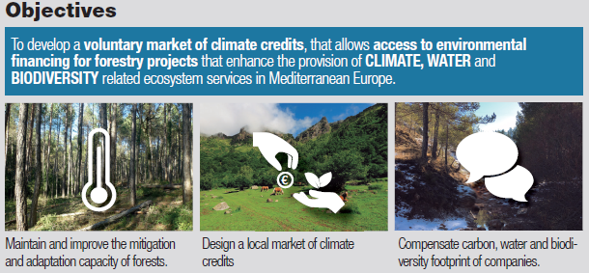
The project: LIFE CLIMARK

Slide 6
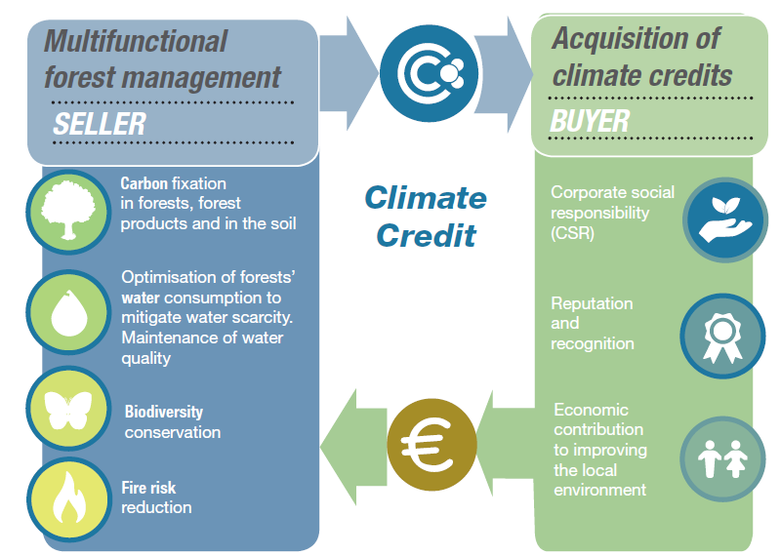
Our product: A new market of climate credits
“The money a company spends to offset their own carbon or water footprint directly goes to forest managers to 'specially' manage the forests, to sequester more C02, produce more water and protect biodiversity”

Slide 7
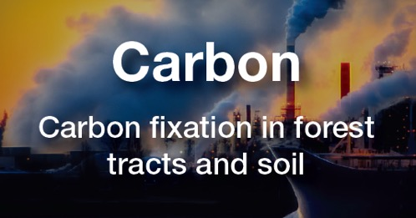
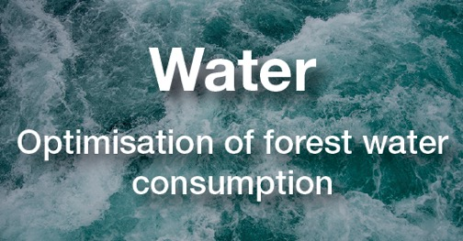
Which are the key features of the Climate Credits?
1
The integrative concept of the Climate Credit itself: valuing, at the same level the co-benefits of MFM on Carbon, Water provision and biodiversity
Quantified impact:
tCO₂ sequestered & tCO₂ avoided
m3 of water produced (less trees, more water !)
% increment in biodiversity hosting capacity (Biodiversity Potential Index -IBP)

Slide 8
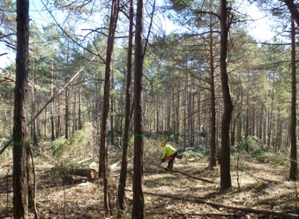
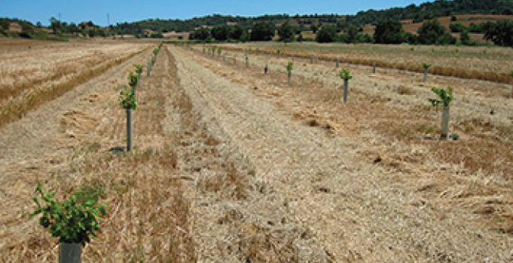
Which are the key features of the Climate Credits?
Thinnings (different species and intensities)
2
A wide list of forestry climate-Smart measures +
The criteria & indicators to measure it
Collaborative definition of what Multifunctional forest management means in each territory
Tree planting (forest plantations & agroforestry)

Slide 9
Which are the key features of the Climate Credits?
3
A Participatory, bottom-up and landscape approach: to increase impact and find synergies with other functions expected from frorests for a given territory
The PROMACC projects
(Forestry Mitigation and Adaptation Projects)
Barcelona
Landscape level maps based on agreed criteria with experts to set priorities for carbon, water or biodiversity
Joint Forestry Management

Slide 10
Scaling-up and replication potential
Starting with existing regional voluntary carbon markets (or similar schemes) as a vehicle to speed up > first climate credit pilot transactions complete by end of this year.
Relevant to other Mediterranean forests
Ease of replication > Set of criteria & indicators defined. Most of them based on internationally tested methodologies

Slide 11
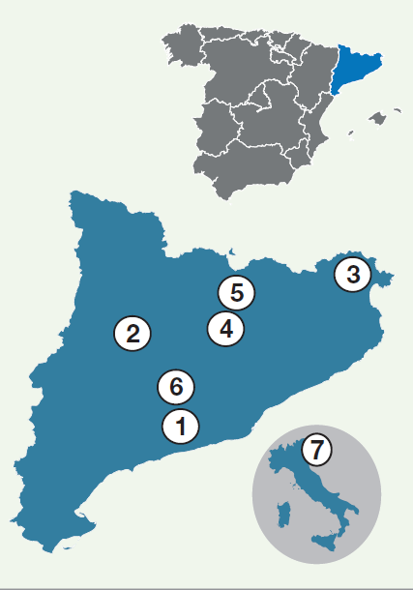
The work behind
3 years of work so far (2018-2021):
Pilot & demonstration sites in 7 locations in Catalonia (Spain) and Veneto (Italy) to test the forestry treatments and select best indicators
Several Expert Committees to ensure reliability of the whole process (on methodologies, CSR…)
Networking with other projects (i.e LIFE ForestCO₂)
Prototype of the Climate Credit market
Sales & Marketing strategy with LIFE C2M team
Barcelona
Venezia
4 pilot projects with first ClimateCredit transactions, in winter 2020
Budget: 1,212,883.00 €

Slide 12
Thank you !
tbaiges@gencat.cat
Teresa Baiges, on behalf of the LIFE CLIMARK Consortium

